Slide 1
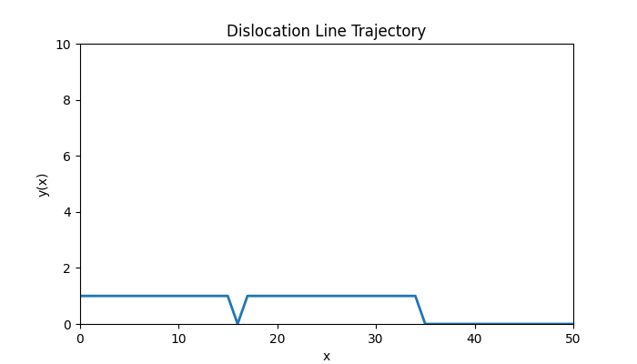
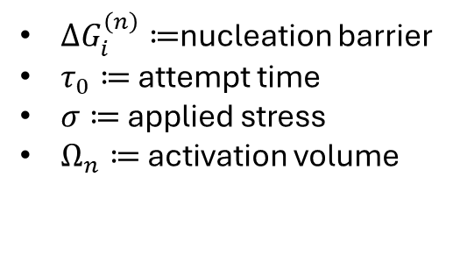
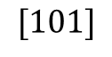
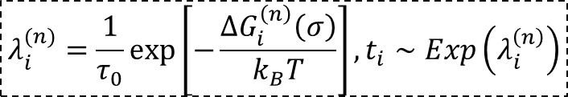
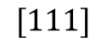
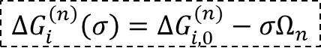
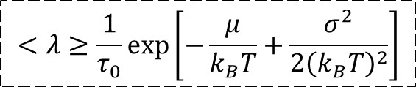
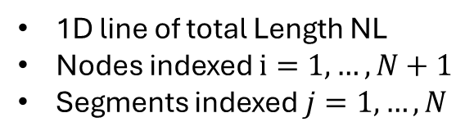
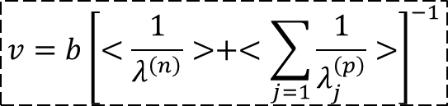
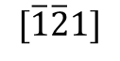
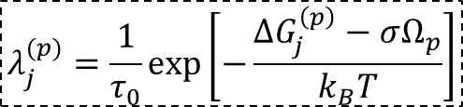
Basic Schematic
$$[101]$$
$$[\overline{1}\overline{2}1]$$
$$[111]$$
1D line of total Length NL
Nodes indexed $i=1,…,N+1$
Segments indexed $j=1,…,N$
2 Stochastic Processes
Nucleation at nodes
Propagation across segments
$$ΔG_{i}^{\left(n\right)}\left(σ\right)=ΔG_{i,0}^{(n)}−σΩ_{n}$$
Series resistance behavior:
Slow nucleation or slow propagation dominates
Barrier distributions matter more than means
$ΔG_{i}^{\left(n\right)}≔$nucleation barrier
$τ_{0}≔$ attempt time
$σ≔$ applied stress
$Ω_{n}≔$ activation volume
$$v=b{\left[<\frac{1}{λ^{\left(n\right)}}>+<\sum_{j=1}{\frac{1}{λ_{j}^{\left(p\right)}}}>\right]}^{−1}$$
$$λ_{i}^{(n)}=\frac{1}{τ_{0}}\exp\left[−\frac{ΔG_{i}^{\left(n\right)}\left(σ\right)}{k_{B}T}\right], t_{i}∼Exp\left(λ_{i}^{\left(n\right)}\right)$$
$$λ_{j}^{(p)}=\frac{1}{τ_{0}}\exp\left[−\frac{ΔG_{j}^{\left(p\right)}−σΩ_{p}}{k_{B}T}\right]$$
$$<λ≥\frac{1}{τ_{0}}\exp\left[−\frac{μ}{k_{B}T}+\frac{σ^{2}}{2{\left(k_{B}T\right)}^{2}}\right]$$

Slide 2
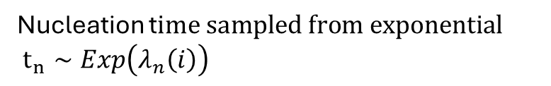
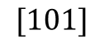
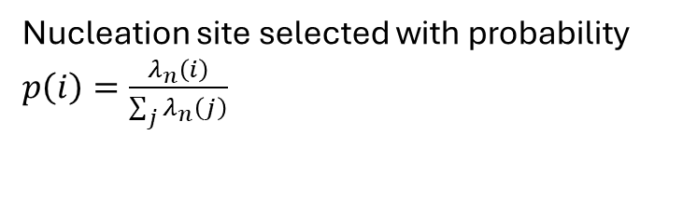
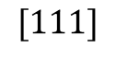
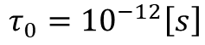
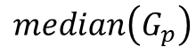
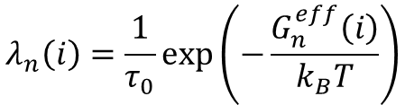
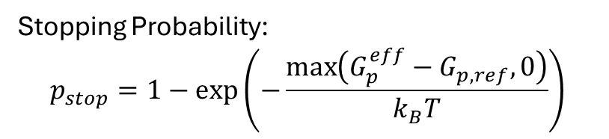
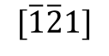
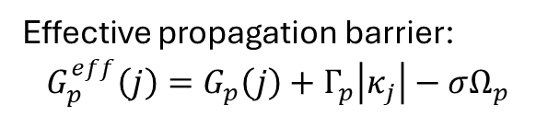
KMC Algorithm
Nucleation
Propagation/migration
$$[101]$$
$$[\overline{1}\overline{2}1]$$
$$[111]$$
Arrhenius nucleation rate:
$$λ_{n}\left(i\right)=\frac{1}{τ_{0}}\exp\left(−\frac{G_{n}^{eff}\left(i\right)}{k_{B}T}\right)$$
Effective propagation barrier:
$$G_{p}^{eff}\left(j\right)=G_{p}\left(j\right)+Γ_{p}\left|κ_{j}\right|−σΩ_{p}$$
$$median\left(G_{p}\right)$$
$$τ_{0}={10}^{−12}\left[s\right]$$
Stopping Probability:
$$p_{stop}=1−\exp\left(−\frac{\max\left(G_{p}^{eff}−G_{p,ref},0\right)}{k_{B}T}\right)$$
Nucleation site selected with probability $p\left(i\right)=\frac{λ_{n}\left(i\right)}{\sum_{j}{λ_{n}\left(j\right)}}$
Nucleation t$ime sampled from exponential$ $t_{n}∼Exp\left(λ_{n}\left(i\right)\right)$

Slide 3
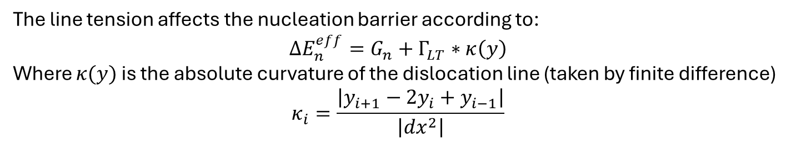
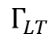
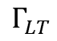
Line Tension
$$Γ_{LT}$$
$$[101]$$
$$[\overline{1}\overline{2}1]$$
$$[111]$$
$$Γ_{LT}$$
The line tension affects the nucleation barrier according to:
$$ΔE_{n}^{eff}=G_{n}+Γ_{LT}∗κ\left(y\right)$$
Where $κ(y)$ is the absolute curvature of the dislocation line (taken by finite difference)
$$κ_{i}=\frac{\left|y_{i+1}−2y_{i}+y_{i−1}\right|}{\left|dx^{2}\right|}$$
Line tension increases the nucleation barrier at positions where the dislocation line is curved. More curved regions require higher activation energy to nucleate, penalizing kinked configurations

Slide 4
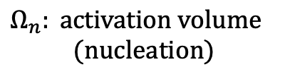
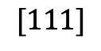
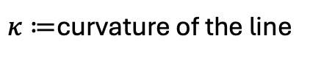
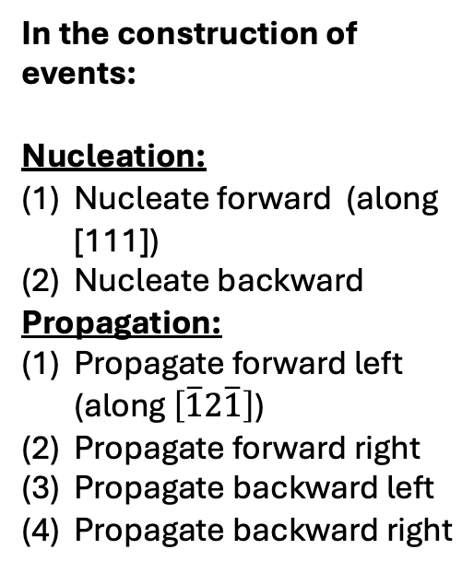
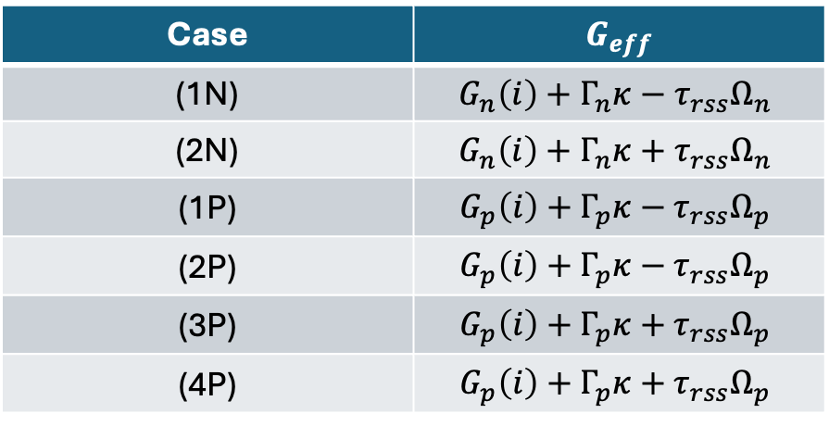
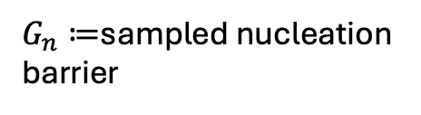
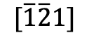
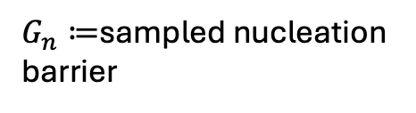
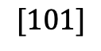
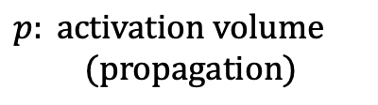
Rate calculation
(2N)
(1N)
(1P)
(4P)
(2P)
(3P)
In the construction of events:
Nucleation:
Nucleate forward (along [111])
Nucleate backward
Propagation:
Propagate forward left (along $\left[\overline{1}2\overline{1}\right]$)
Propagate forward right
Propagate backward left
Propagate backward right
left
forward
right
$$[101]$$
$$[\overline{1}\overline{2}1]$$
$$[111]$$
$G_{n}≔$sampled nucleation barrier
In the construction of barriers:
$G_{n}≔$sampled nucleation barrier
Case | $$G_{eff}$$
(1N) | $$G_{n}\left(i\right)+Γ_{n}κ−τ_{rss}Ω_{n}$$
(2N) | $$G_{n}\left(i\right)+Γ_{n}κ+τ_{rss}Ω_{n}$$
(1P) | $$G_{p}\left(i\right)+Γ_{p}κ−τ_{rss}Ω_{p}$$
(2P) | $$G_{p}\left(i\right)+Γ_{p}κ−τ_{rss}Ω_{p}$$
(3P) | $$G_{p}\left(i\right)+Γ_{p}κ+τ_{rss}Ω_{p}$$
(4P) | $$G_{p}\left(i\right)+Γ_{p}κ+τ_{rss}Ω_{p}$$
$κ≔$curvature of the line
$Ω_{n}: activation volume$
$$(nucleation)$$
$p: activation volume$
$$(propagation)$$

Slide 5
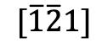
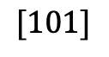
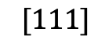
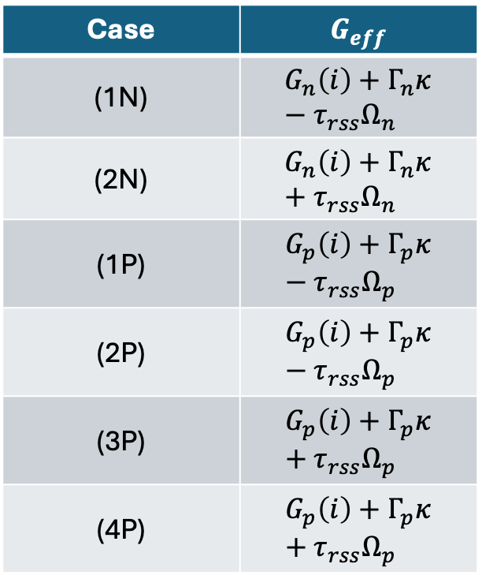
Issues with current method and proposed correction
Proposed Solution: analyze the event in question to determine how it affects the energy barrier on the fly
(2N)
(1N)
(1P)
(4P)
(2P)
(3P)
left
forward
right
$$[101]$$
Case | $$G_{eff}$$
(1N) | $$G_{n}\left(i\right)+Γ_{n}κ−τ_{rss}Ω_{n}$$
(2N) | $$G_{n}\left(i\right)+Γ_{n}κ+τ_{rss}Ω_{n}$$
(1P) | $$G_{p}\left(i\right)+Γ_{p}κ−τ_{rss}Ω_{p}$$
(2P) | $$G_{p}\left(i\right)+Γ_{p}κ−τ_{rss}Ω_{p}$$
(3P) | $$G_{p}\left(i\right)+Γ_{p}κ+τ_{rss}Ω_{p}$$
(4P) | $$G_{p}\left(i\right)+Γ_{p}κ+τ_{rss}Ω_{p}$$
$$[\overline{1}\overline{2}1]$$
$$[111]$$
Should $Γ_{p}$ raise the energy barrier for all of these cases?

Slide 6
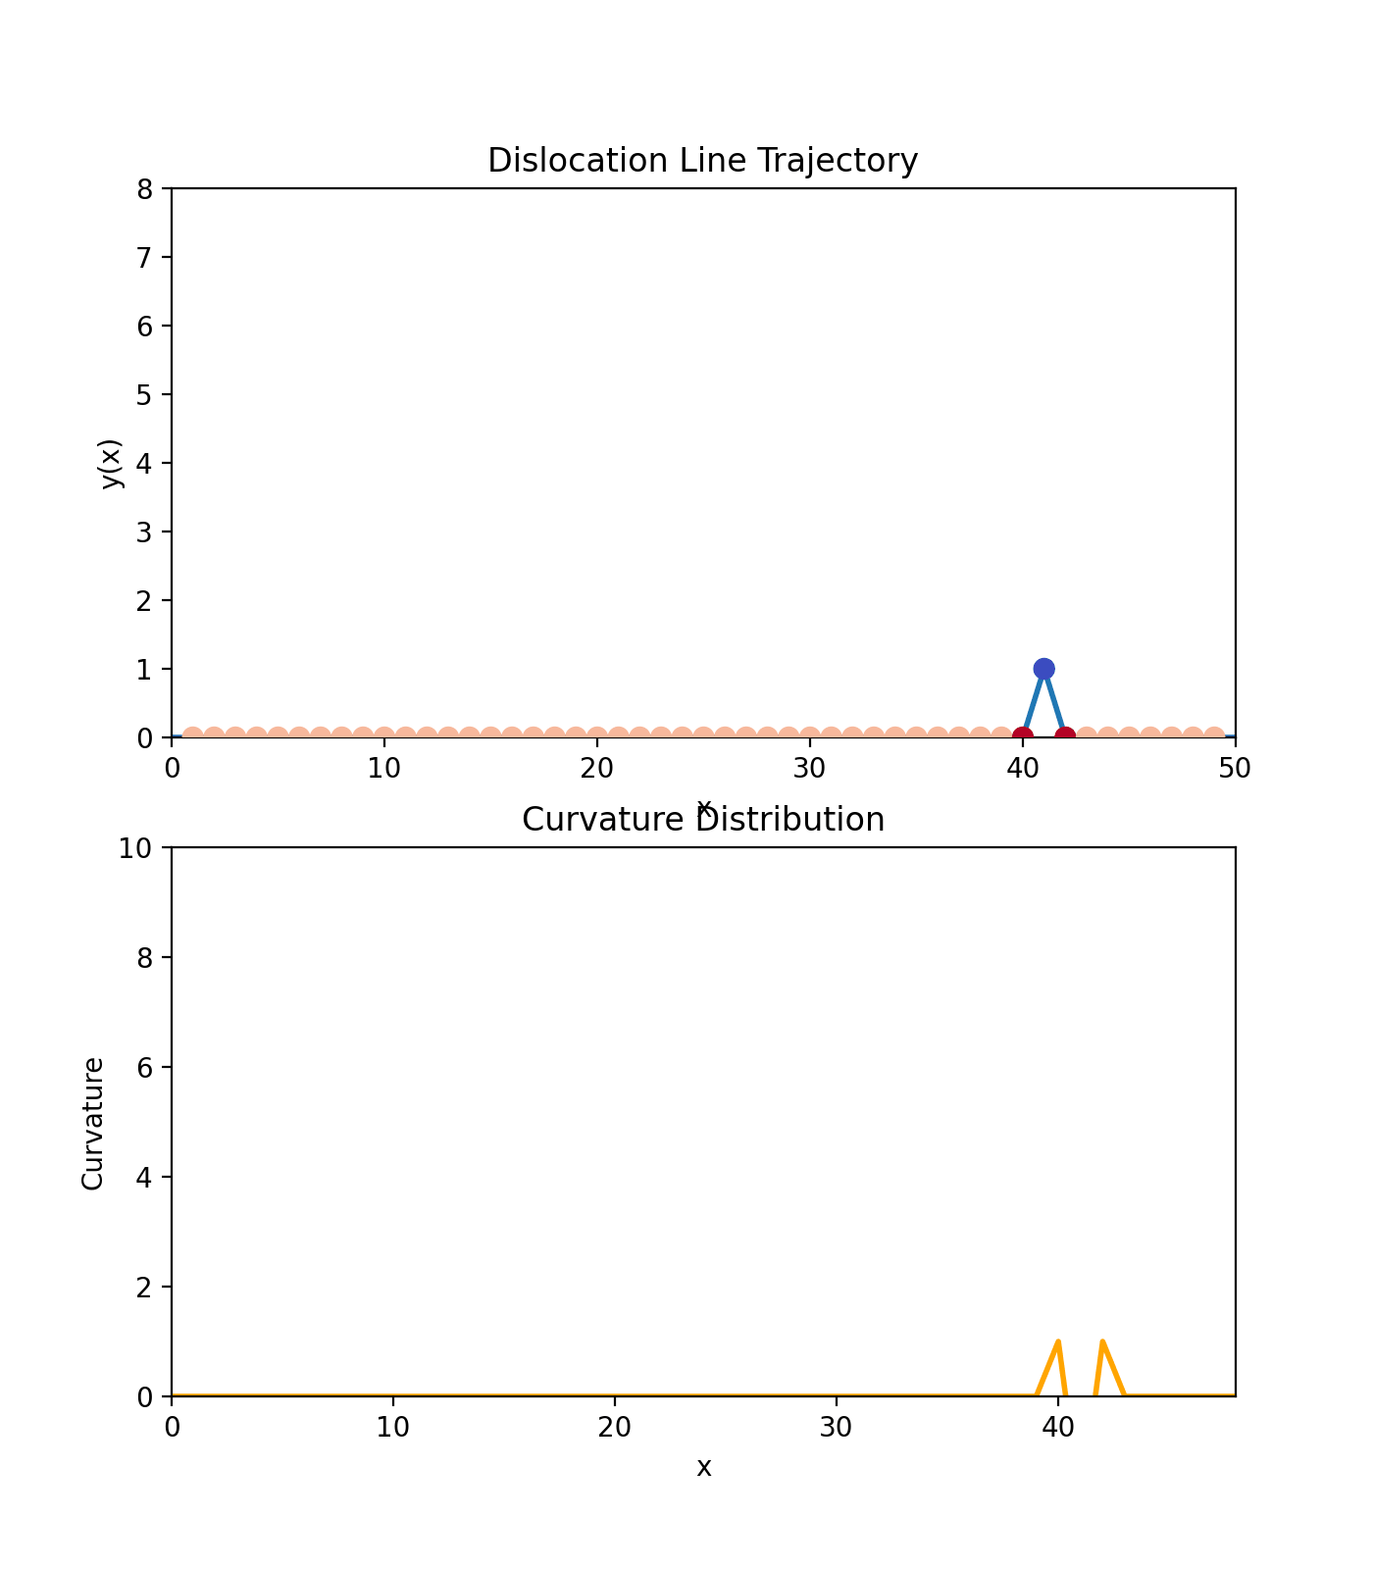
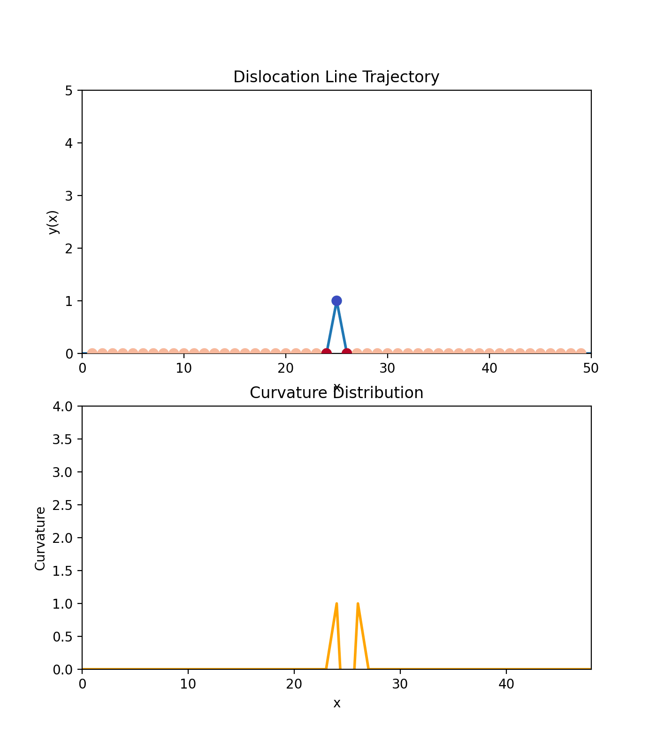
Validation Procedures: Curvature analysis point by point
"Gamma_n":0.5,
"Gamma_p":0.5,
"mu_n":0.8,
"sig_n":0.1,
"mu_p":0.05,
"sig_p":0.05,
“stress”:1
"Gamma_n":0.1,
"Gamma_p":0.1,

Slide 7
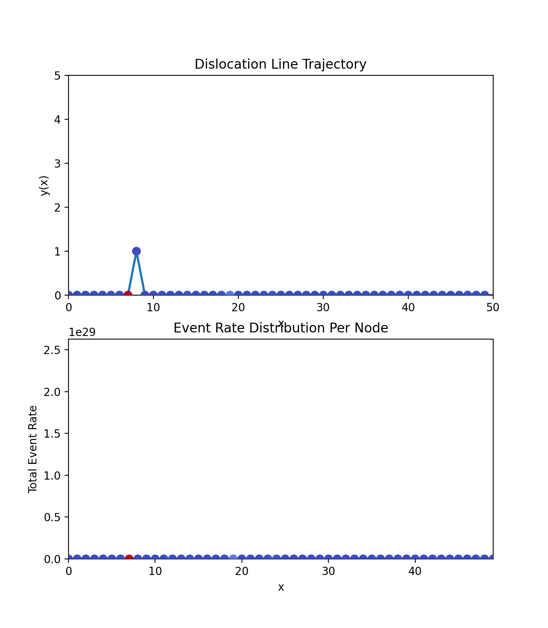
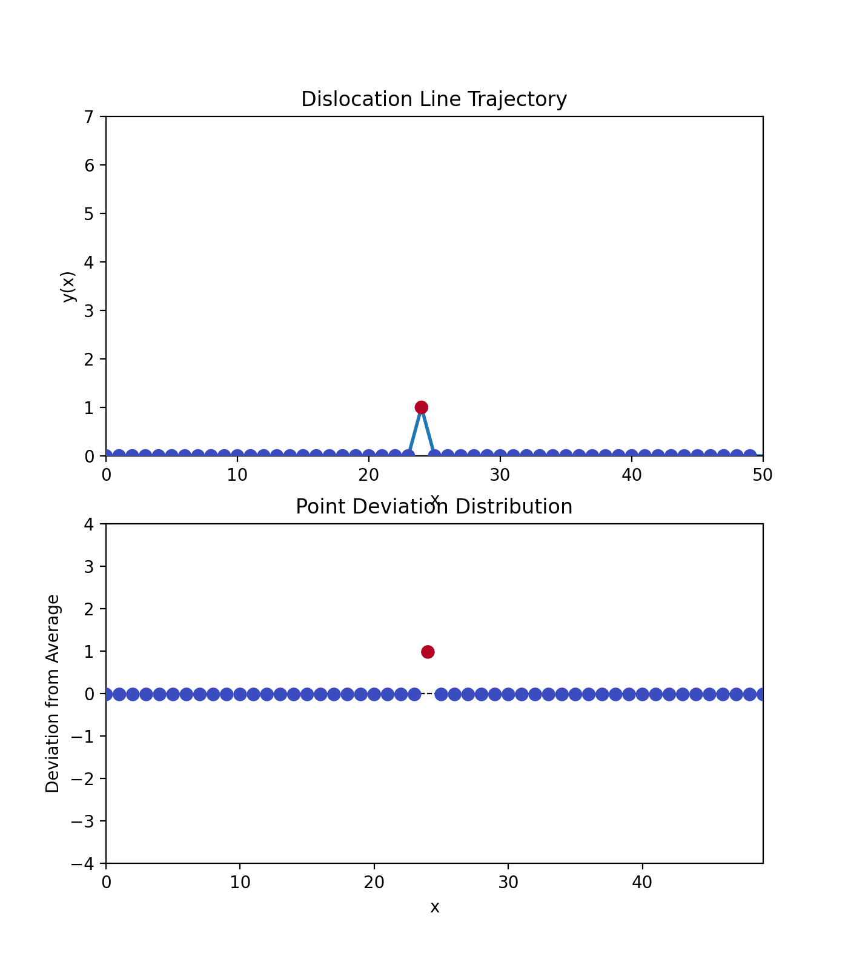
Validation Procedures: Point density distribution
Validation Procedures: calculated rate distribution

Slide 9
Calibration (TBD)

Slide 10
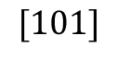
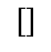
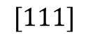
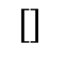
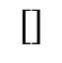
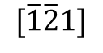
Cross-kinking (TBD)
$$[]$$
$$[]$$
$$[]$$
$$[101]$$
$$[\overline{1}\overline{2}1]$$
$$[111]$$

